Slide 1


Build native and hybrid mobile apps with Mobile Blazor Bindings
Eilon Lipton
@original_ejl

Slide 2
I want to build an app…
For Web, Mobile, or Desktop?
Choose one
☹

Slide 3
Hybrid Apps
Take your web skills, web assets, and web code
And run them in a native app alongside native UI
Share as much as you want; diverge where it makes sense

Slide 4
What Blazor can do for you
Use Blazor Web for your web app
And host the exact same UI in your mobile and desktop apps
With native device access
Including native UI
All with one UI development pattern

Slide 5

Mobile Blazor Bindings
Author native UI using Blazor syntax
Host Blazor Web content in a Web View to run locally
Run natively on Android, iOS, macOS, and Windows
Access all native functions of each platform

Slide 6
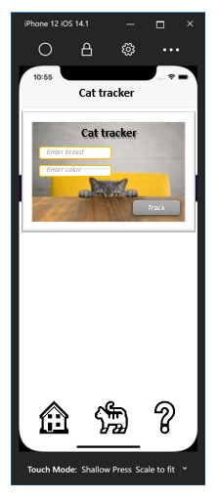
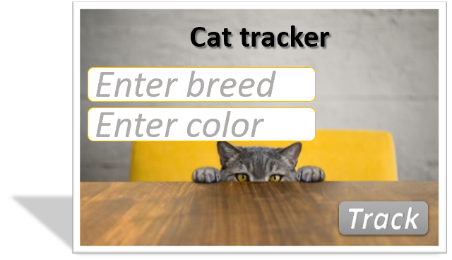
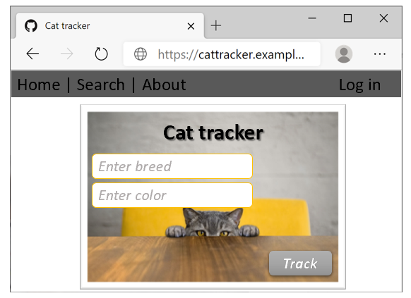
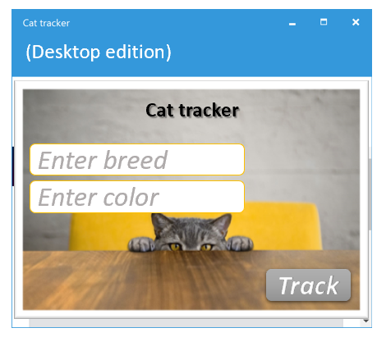
Unified UI with Blazor Web
Blazor Hybrid (mobile)
Blazor Web (UI Library)
Blazor Web
Blazor Hybrid (desktop)

Slide 7
Blazor Hybrid Code Sample
<StackLayout>
<@* Native UI goes here *@>
<Button ... />
<@* Web UI is hosted here *@>
<BlazorWebView>
<MyWebCode.WebUI.App />
</BlazorWebView>
</StackLayout>
Native UI
Web UI

Slide 8
Cat Tracker Hybrid App
Eilon Lipton
https://github.com/Eilon/CatTrackerDemo

Slide 9
How it works
On the web it’s plain old Blazor
On desktop/mobile the code runs locally on the device
No web server
All Blazor code is compiled to C# and runs in-proc
Share any state across the app

Slide 10
Cat Tracker Deep Dive
Eilon Lipton
https://github.com/Eilon/CatTrackerDemo

Slide 11
Mobile Blazor Bindings Preview 5
Use Blazor Web UI in desktop/mobile apps
SkiaSharp for 2D graphics
Blazor URL-based navigation for native UI
Also: gesture recognizers, dual-screen, and more!
https://aka.ms/mbb-preview5-blog

Slide 12
Future focus
Auth support, such as OpenID Connect
Templated control support (CollectionView)
HTML-only apps
Tell us your app’s needs and scenarios!

Slide 13

Thanks for joining!

